Slide 1


Machine Learning 4. Logistic Regression
Xueyuan Gong
School of Intelligent Systems Science and Engineering

Slide 2
Classification
Binary classification: predicting a binary-valued target
Multiclass classification: predicting a discrete(> 2)-valued target
Examples of binary classification
Predict whether a patient has a disease, given the presence or absence of various symptoms
Classify e-mails as spam or non-spam
Predict whether a financial transaction is fraudulent

Slide 3
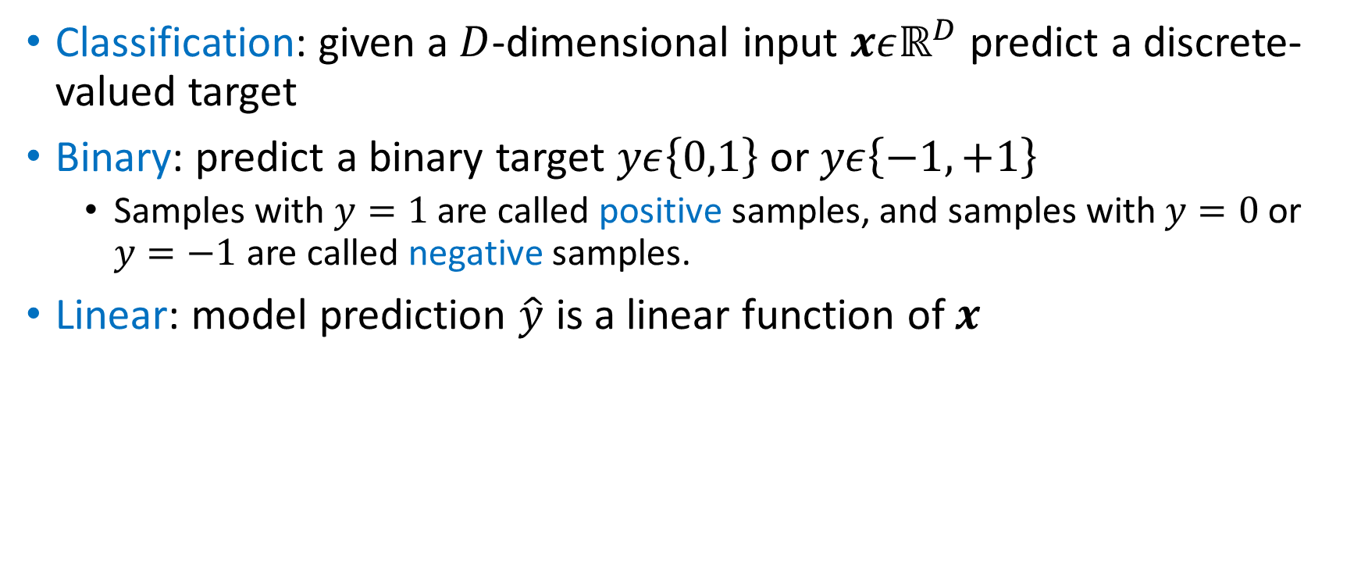
Binary Linear Classification
Classification: given a $D$-dimensional input $xεℝ^{D}$ predict a discrete-valued target
Binary: predict a binary target $yε\left\{0,1\right\}$ or $yε\left\{−1,+1\right\}$
Samples with $y=1$ are called positive samples, and samples with $y=0$ or $y=−1$ are called negative samples.
Linear: model prediction $\hat{y}$ is a linear function of $x$

Slide 4
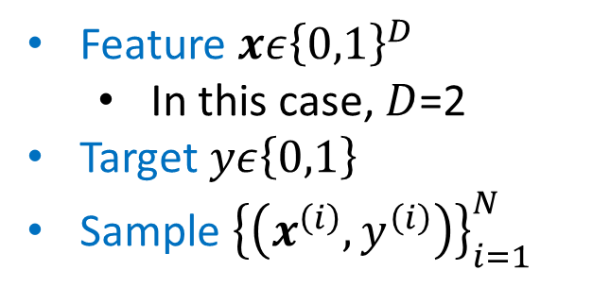
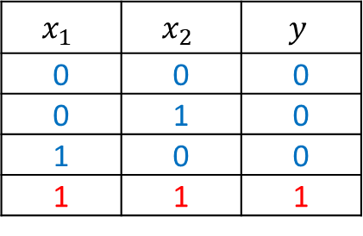
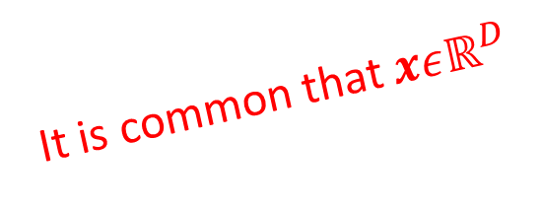
AND Problem
Dataset
Feature $xε{\left\{0,1\right\}}^{D}$
In this case, $D$=2
Target $yε\left\{0,1\right\}$
Sample ${\left\{\left(x^{\left(i\right)},y^{\left(i\right)}\right)\right\}}_{i=1}^{N}$
$$x_{1}$$ | $$x_{2}$$ | $$y$$
0 | 0 | 0
0 | 1 | 0
1 | 0 | 0
1 | 1 | 1
It is common that $xεℝ^{D}$
What is the biggest difference between regression and classification?

Slide 5
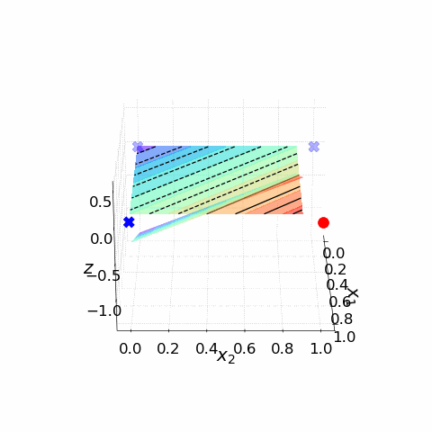
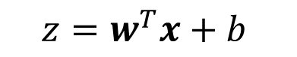
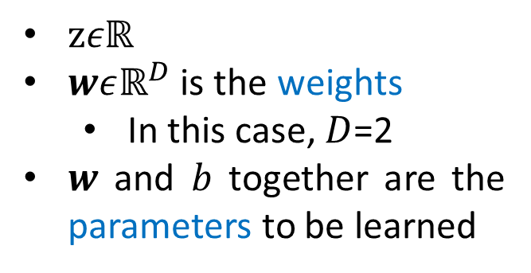
AND Problem
Model
$$z=w^{T}x+b$$
$zεℝ$
$wεℝ^{D}$ is the weights
In this case, $D$=2
$w$ and $b$ together are the parameters to be learned

Slide 6
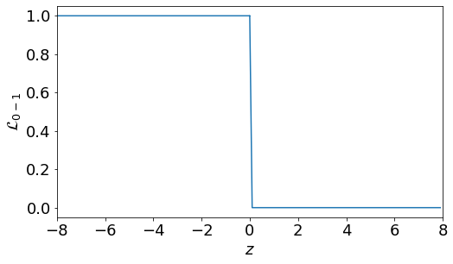
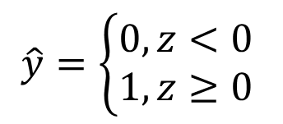
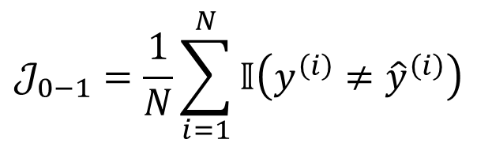
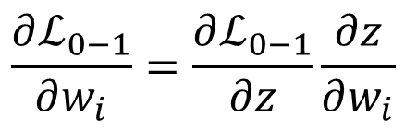
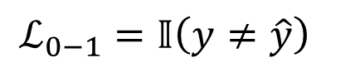

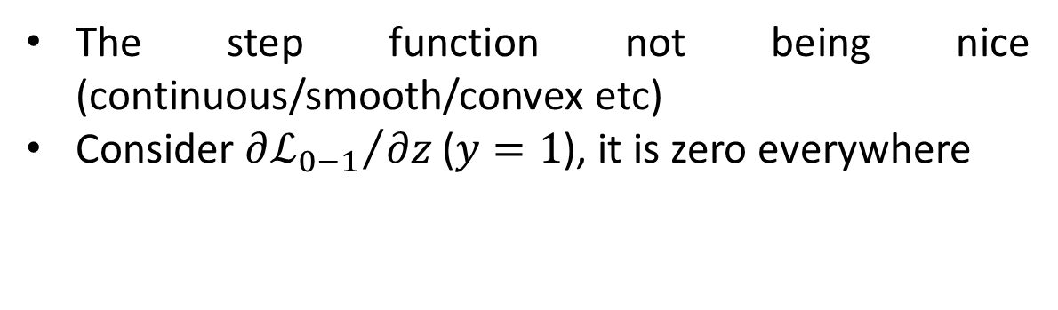
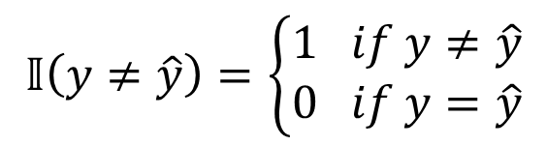
Attempt 1: 0-1 Loss
Loss Function
The step function not being nice (continuous/smooth/convex etc)
Consider ${∂ℒ_{0−1}}/{∂z}$ ($y=1$), it is zero everywhere
$$ℒ_{0−1}=𝕀\left(y≠\hat{y}\right)$$
$$𝕀\left(y≠\hat{y}\right)=\left\{\begin{aligned}1 if y≠\hat{y} \\ 0 if y=\hat{y}\end{aligned}\right.$$
$$\hat{y}=\left\{\begin{aligned}0,z<0 \\ 1,z≥0\end{aligned}\right.$$
Cost Function
Chain Rule!!!
How about ${∂ℒ_{0−1}}/{∂w_{i}}$
$$𝒥_{0−1}=\frac{1}{N}\sum_{i=1}^{N}{𝕀\left({y^{\left(i\right)}≠\hat{y}}^{\left(i\right)}\right)}$$
$$\frac{∂ℒ_{0−1}}{∂w_{i}}=\frac{∂ℒ_{0−1}}{∂z}\frac{∂z}{∂w_{i}}$$

Slide 7
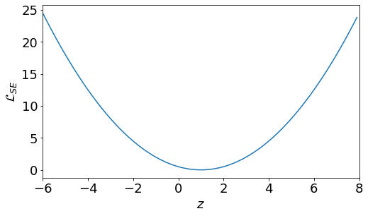
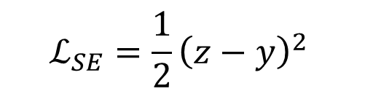
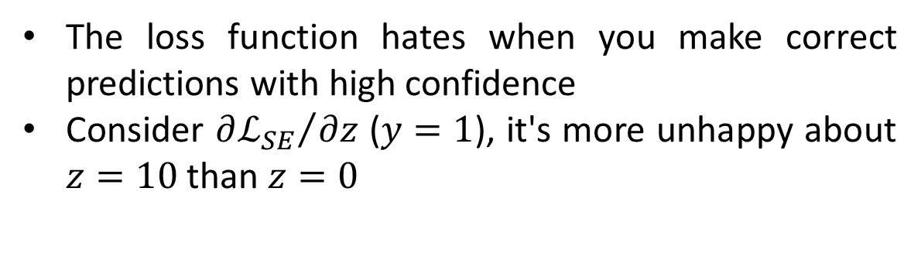
Attempt 2: Linear Regression
Loss Function
The loss function hates when you make correct predictions with high confidence
Consider ${∂ℒ_{SE}}/{∂z}$ ($y=1$), it's more unhappy about $z=10$ than $z=0$
$$ℒ_{SE}=\frac{1}{2}{\left(z−y\right)}^{2}$$
Squared error
Doesn't matter that the targets are actually binary. Treat them as continuous values

Slide 8
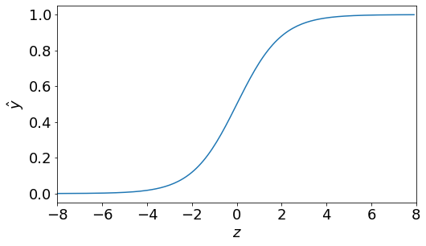
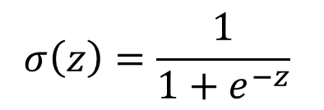
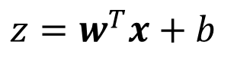
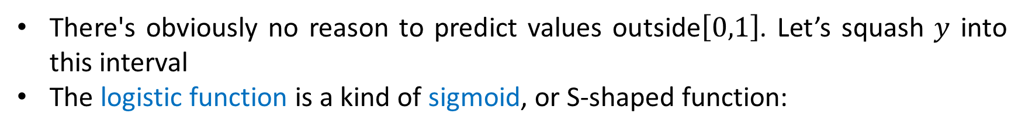
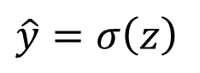
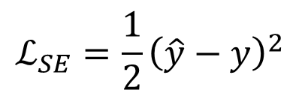
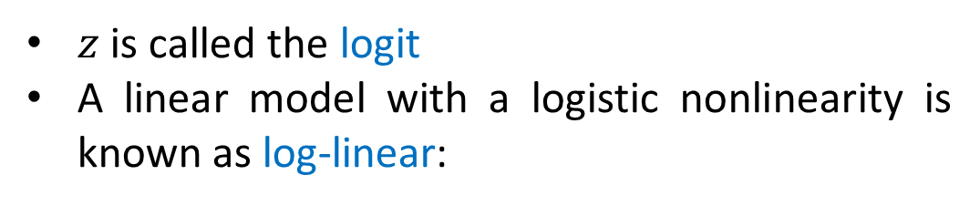
Attempt 3: Sigmoid Function
There's obviously no reason to predict values outside$\left[0,1\right]$. Let’s squash $y$ into this interval
The logistic function is a kind of sigmoid, or S-shaped function:
$$σ\left(z\right)=\frac{1}{1+e^{−z}}$$
$z$ is called the logit
A linear model with a logistic nonlinearity is known as log-linear:
$$ℒ_{SE}=\frac{1}{2}{\left(\hat{y}−y\right)}^{2}$$
$$z=w^{T}x+b$$
$$\hat{y}=σ\left(z\right)$$
Used in this way, $σ\left(z\right)$ is called an activation function

Slide 9
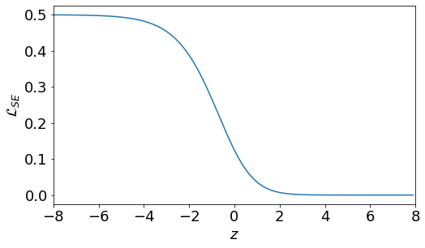
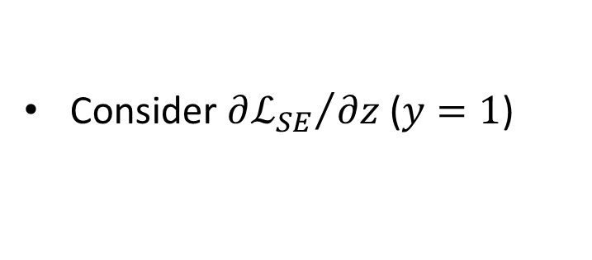
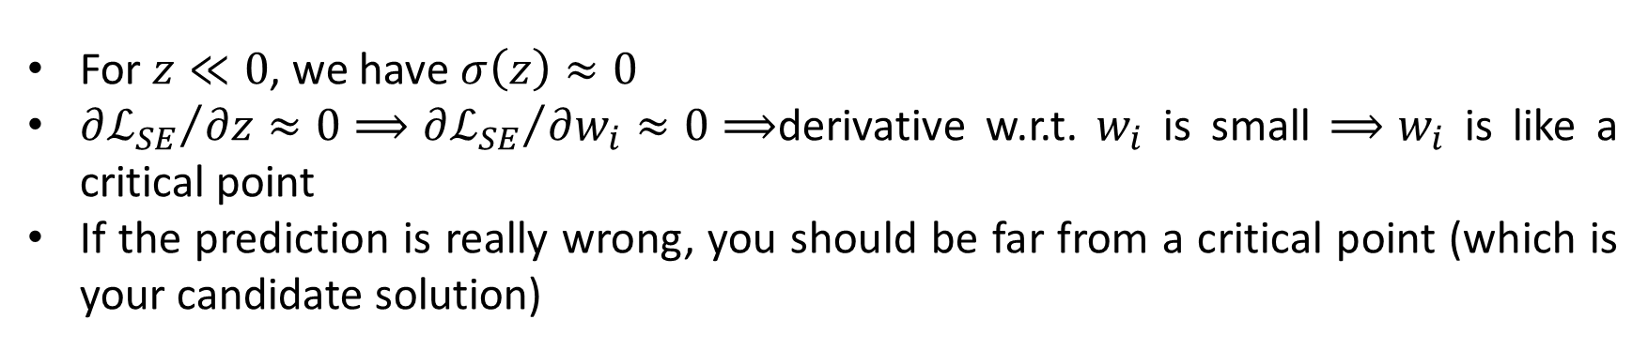
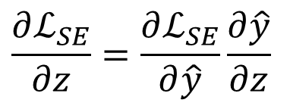
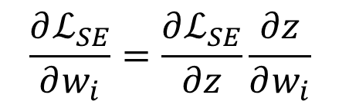
Attempt 3: Sigmoid Function
Consider ${∂ℒ_{SE}}/{∂z}$ ($y=1$)
$$\frac{∂ℒ_{SE}}{∂w_{i}}=\frac{∂ℒ_{SE}}{∂z}\frac{∂z}{∂w_{i}}$$
$$\frac{∂ℒ_{SE}}{∂z}=\frac{∂ℒ_{SE}}{∂\hat{y}}\frac{∂\hat{y}}{∂z}$$
For $z≪0$, we have $σ\left(z\right)≈0$
${∂ℒ_{SE}}/{∂z}≈0⟹{∂ℒ_{SE}}/{∂w_{i}}≈0⟹$derivative w.r.t. $w_{i}$ is small $⟹w_{i}$ is like a critical point
If the prediction is really wrong, you should be far from a critical point (which is your candidate solution)

Slide 10
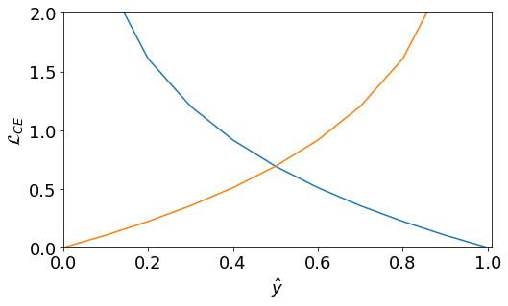
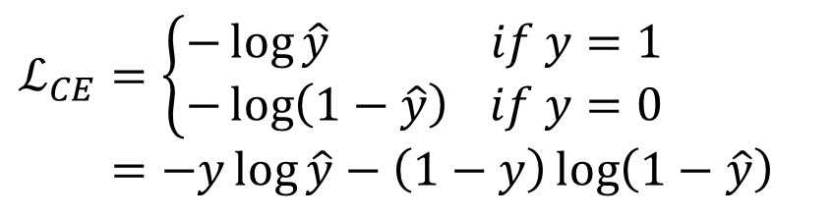
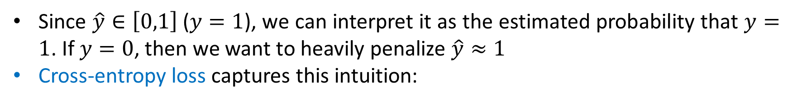
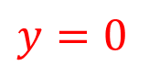
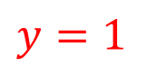
Logistic Regression
Since $\hat{y}∈\left[0,1\right]$ ($y=1$), we can interpret it as the estimated probability that $y=1$. If $y=0$, then we want to heavily penalize $\hat{y}≈1$
Cross-entropy loss captures this intuition:
$$ℒ_{CE}=\left\{\begin{aligned}−\log{\hat{y}} if y=1 \\ −\log\left(1−\hat{y}\right) if y=0\end{aligned}\right.=−y\log{\hat{y}}−\left(1−y\right)\log\left(1−\hat{y}\right)$$
$$y=0$$
$$y=1$$

Slide 11
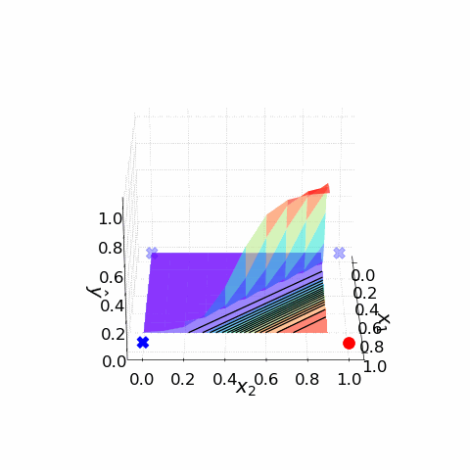
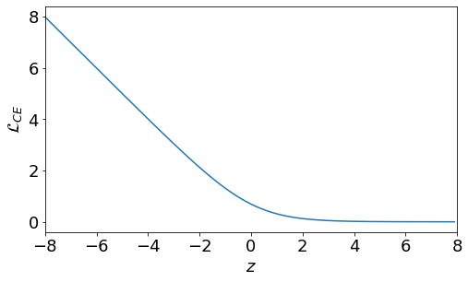
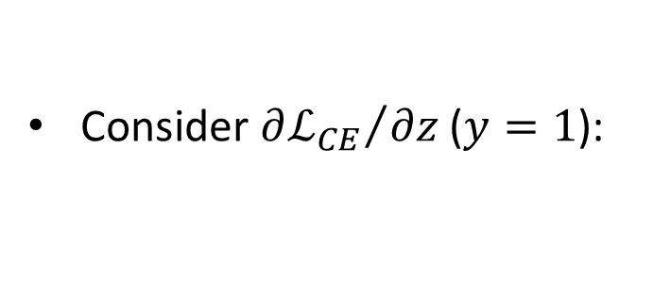
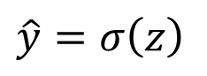
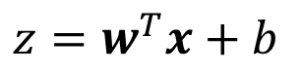
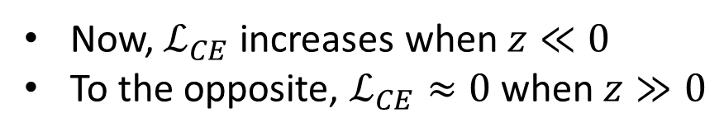
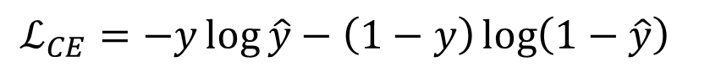
Logistic Regression
Model
$$z=w^{T}x+b$$
$$\hat{y}=σ\left(z\right)$$
Loss Function
Consider ${∂ℒ_{CE}}/{∂z}$ ($y=1$):
$$ℒ_{CE}=−y\log{\hat{y}}−\left(1−y\right)\log\left(1−\hat{y}\right)$$
Now, $ℒ_{CE}$ increases when $z≪0$
To the opposite, $ℒ_{CE}≈0$ when $z≫0$

Slide 12
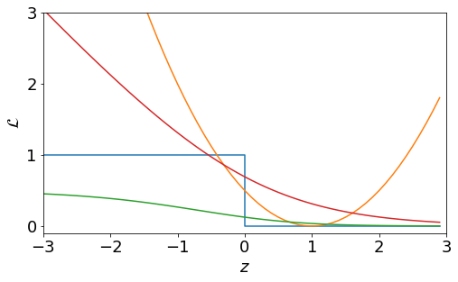
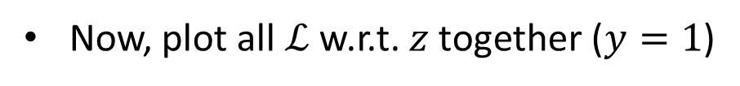
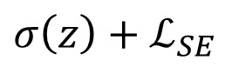
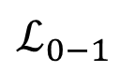
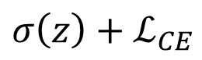
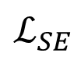
Comparison of Loss Functions
Now, plot all $ℒ$ w.r.t. $z$ together ($y=1$)
$$ℒ_{0−1}$$
$$ℒ_{SE}$$
$${σ\left(z\right)+ℒ}_{SE}$$
$${σ\left(z\right)+ℒ}_{CE}$$

Slide 13
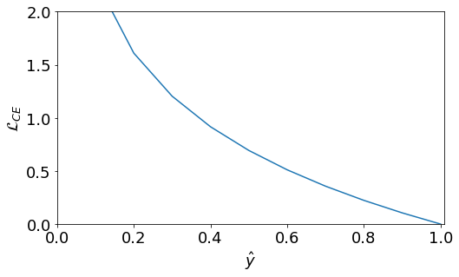
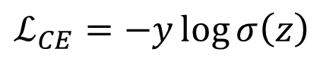
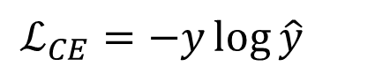



*Numerical Stability
$$\hat{y}=σ\left(z\right)$$
Consider when $z≪0$ ($y=1$)
If $y$ is small enough, it may be numerically zero. This can cause very subtle and hard-to-find bugs
$\hat{y}=σ\left(z\right)$ $⟹$ $\hat{y}≈0$
$ℒ_{CE}=−y\log{\hat{y}}$ $⟹$ computes $\log{0}$
Instead, we could combine the activation function and the loss into a single logistic-cross-entropy function
$$ℒ_{CE}=−y\log{\hat{y}}$$
$$ℒ_{CE}\left(\hat{y},y\right)=ℒ_{CE}\left(σ\left(z\right),y\right)=y\log\left(1+e^{−z}\right)+\left(1−y\right)\log\left(1+e^{z}\right)$$
$$ℒ_{CE}=−y\log{σ\left(z\right)}$$

Slide 14











Gradient Descent
Model
$$\hat{y}=σ\left(z\right)=\frac{1}{1+e^{−z}}$$
$$z=w^{T}x+b$$
$$ℒ_{CE}=−y\log{\hat{y}}−\left(1−y\right)\log\left(1−\hat{y}\right)$$
Calculate Gradient
$$∇𝒥\left(w,b\right)=\left[\begin{matrix}\frac{∂𝒥}{∂w} \\ \frac{∂𝒥}{∂b}\end{matrix}\right]=\left[\begin{matrix}\frac{1}{N}\sum_{i=1}^{N}{\frac{∂ℒ}{∂w}} \\ \frac{1}{N}\sum_{i=1}^{N}{\frac{∂ℒ}{∂b}}\end{matrix}\right]$$
$$\frac{∂ℒ_{CE}}{∂w_{i}}=$$
$$\frac{∂ℒ_{CE}}{∂\hat{y}}\frac{∂\hat{y}}{∂z}\frac{∂z}{∂w_{i}}$$
$$=\left(−\frac{y}{\hat{y}}+\frac{1−y}{1−\hat{y}}\right)\hat{y}\left(1−\hat{y}\right)x_{i}=\left(\hat{y}−y\right)x_{i}$$
$$\frac{∂ℒ_{CE}}{∂b}=$$
$$\left(\hat{y}−y\right)$$
Update
$$w_{i}=w_{i}−α\frac{∂𝒥}{∂w_{i}}=w_{i}−\frac{α}{N}\sum_{j=1}^{N}{\left({\hat{y}}^{\left(j\right)}−y^{\left(j\right)}\right)x_{i}^{\left(j\right)}}$$
$$b=b−α\frac{∂𝒥}{∂b}=b−\frac{α}{N}\sum_{j=1}^{N}{\left({\hat{y}}^{\left(j\right)}−y^{\left(j\right)}\right)}$$

Slide 15
Thank you！

